Slide 1


Machine Learning
An Introduction to the World of Intelligent Systems

Slide 2

Powering Our Modern World
Machine learning (ML) powers some of the most important technologies we use, from translation apps to autonomous vehicles. ML can predict the weather, estimate travel times, recommend songs, auto-complete sentences, summarize articles, and generate never-seen-before images.

Slide 3
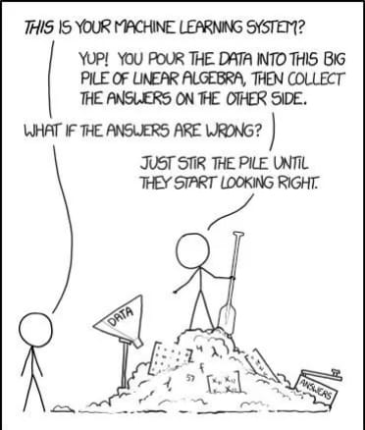
What is Machine Learning?
In basic terms, ML is the process of training a piece of software, called a model, to make useful predictions or generate content (like text, images, audio, or video) from data.

Slide 4
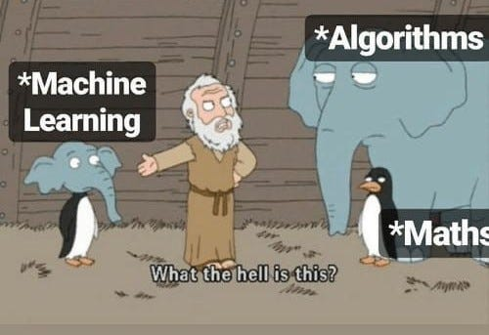

Slide 5
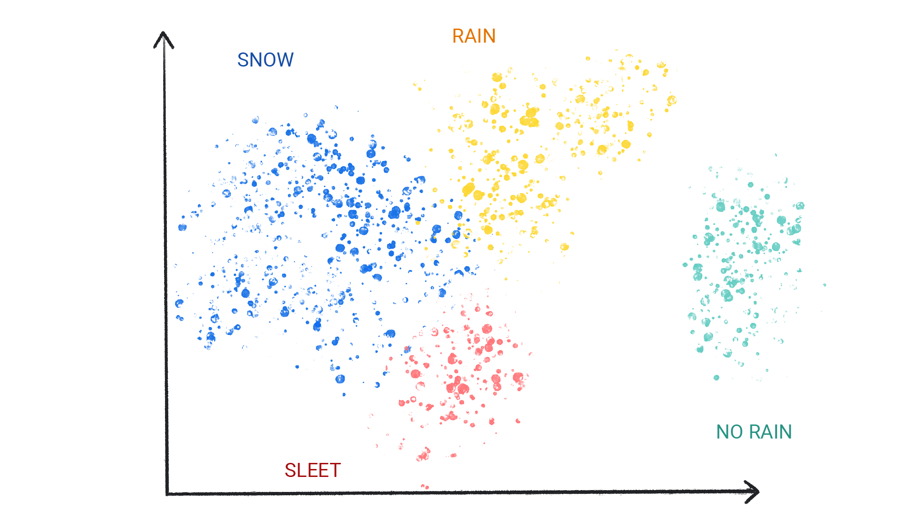
The Rainfall Prediction Challenge
For example, suppose we wanted to create an app to predict rainfall. We could use either a traditional approach or an ML approach. Using a traditional approach, we'd create a physics-based representation of the Earth's atmosphere and surface, computing massive amounts of fluid dynamics equations. This is incredibly difficult.

Slide 6

Categories of Machine Learning
ML systems fall into one or more of the following categories based on how they learn to make predictions or generate content:
Supervised learning
Unsupervised learning
Reinforcement learning
Generative AI

Slide 7
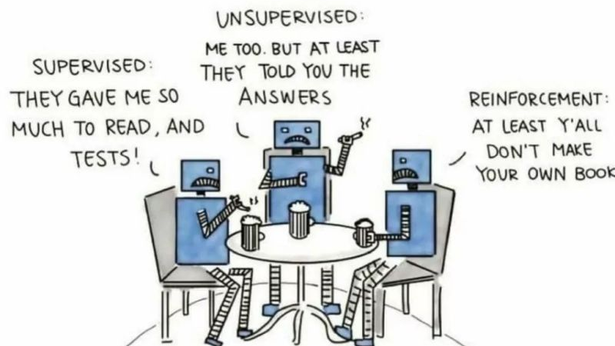

Slide 8


Slide 9
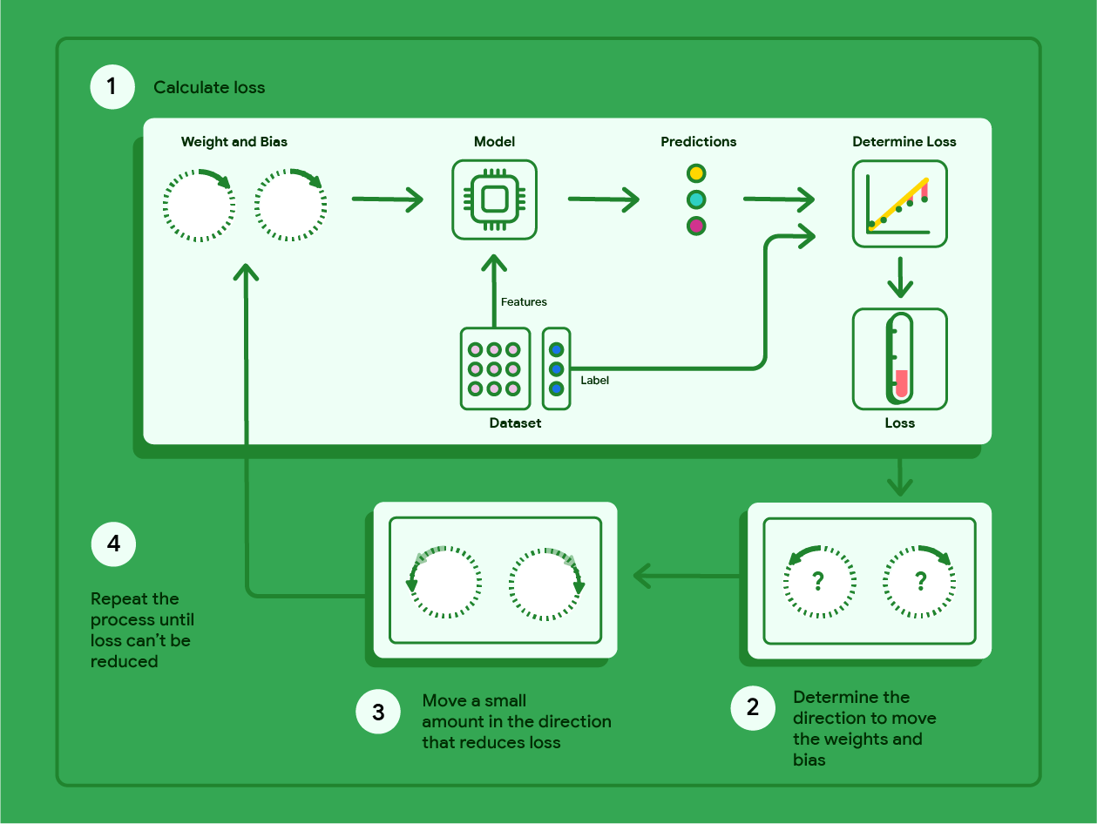
Machine Learning Life Cycle

Slide 10
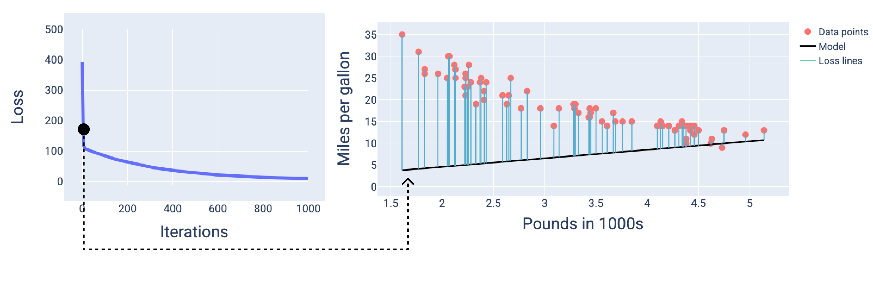

Slide 11
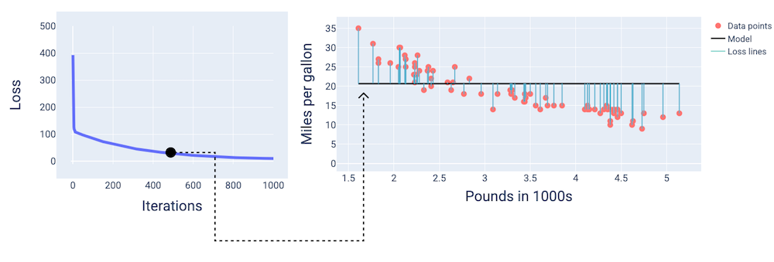

Slide 12
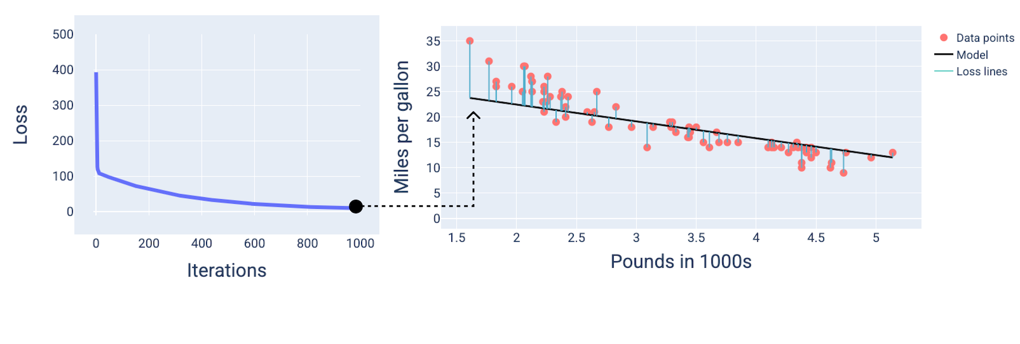

Slide 13
Learning Through Interaction and Creation (Advanced)
Reinforcement Learning
Here, an agent learns to make decisions by interacting with an environment, receiving rewards for desired actions and penalties for undesired ones. It's how AI masters complex games or navigates autonomous systems.
Generative AI
This advanced form of ML focuses on creating new content, from realistic images and text to music and video. It learns the underlying patterns of existing data to generate novel outputs, often indistinguishable from human-created work.

Slide 14
